Slide 1
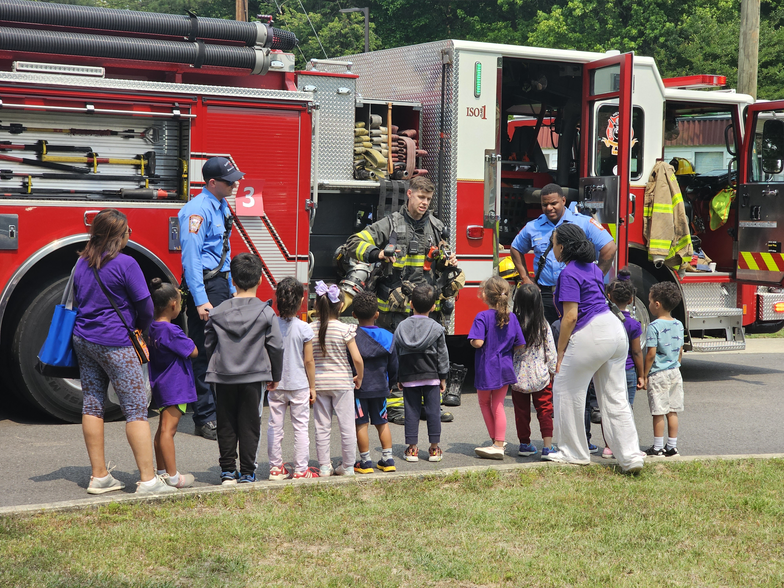
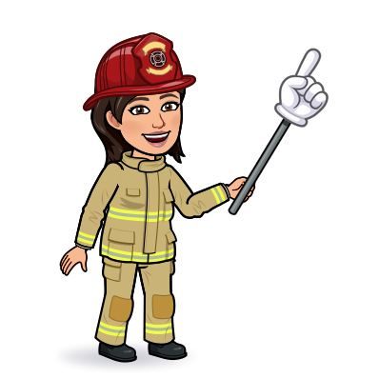

4th & 5th Grade
Fire Safety

Slide 2
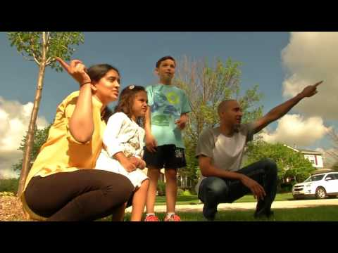
The Speed of Fire
Why is it important to have working smoke alarms?
How often should you test your smoke alarms?
Where is a good meeting place for where you live?

Slide 3
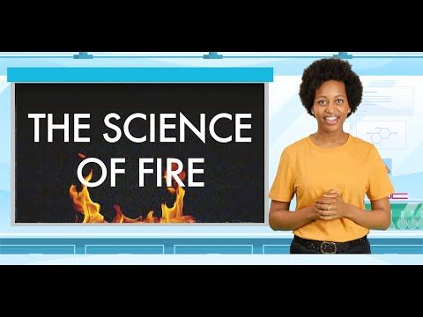
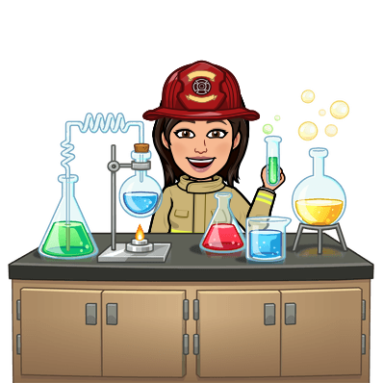
The Science of Fire!
Welcome to the laboratory!
Learn all about fire, the fire triangle, and how you can stay safe.

Slide 4
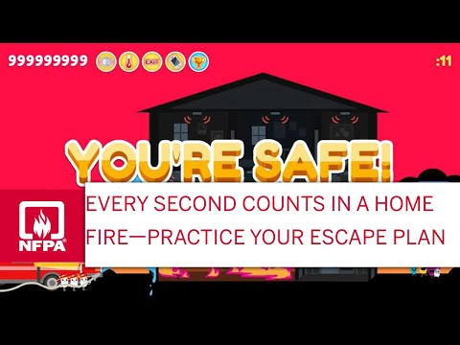
Know your Escape Plan
Your family should discuss an escape plan for:
Younger siblings
2nd floor exits/use of Home Escape Ladders
Older adults or people with disabilities
Pets

Slide 5
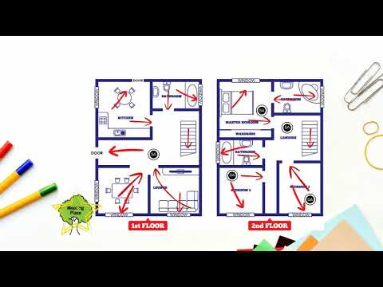
Let's Make a Home Escape Plan
5 minute activity:
Draw a map of your home that shows all doors and windows
Mark 2 ways out of each room
Pick a family meeting place outside
Share this with your family!

Slide 6
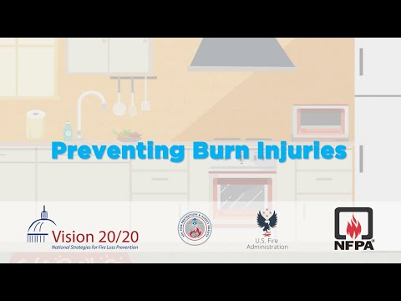

Preventing Burn Injuries
Use cool water for 3-5 minutes immediately to treat a burn
Keep a 3ft safety zone around things that get hot

Slide 7
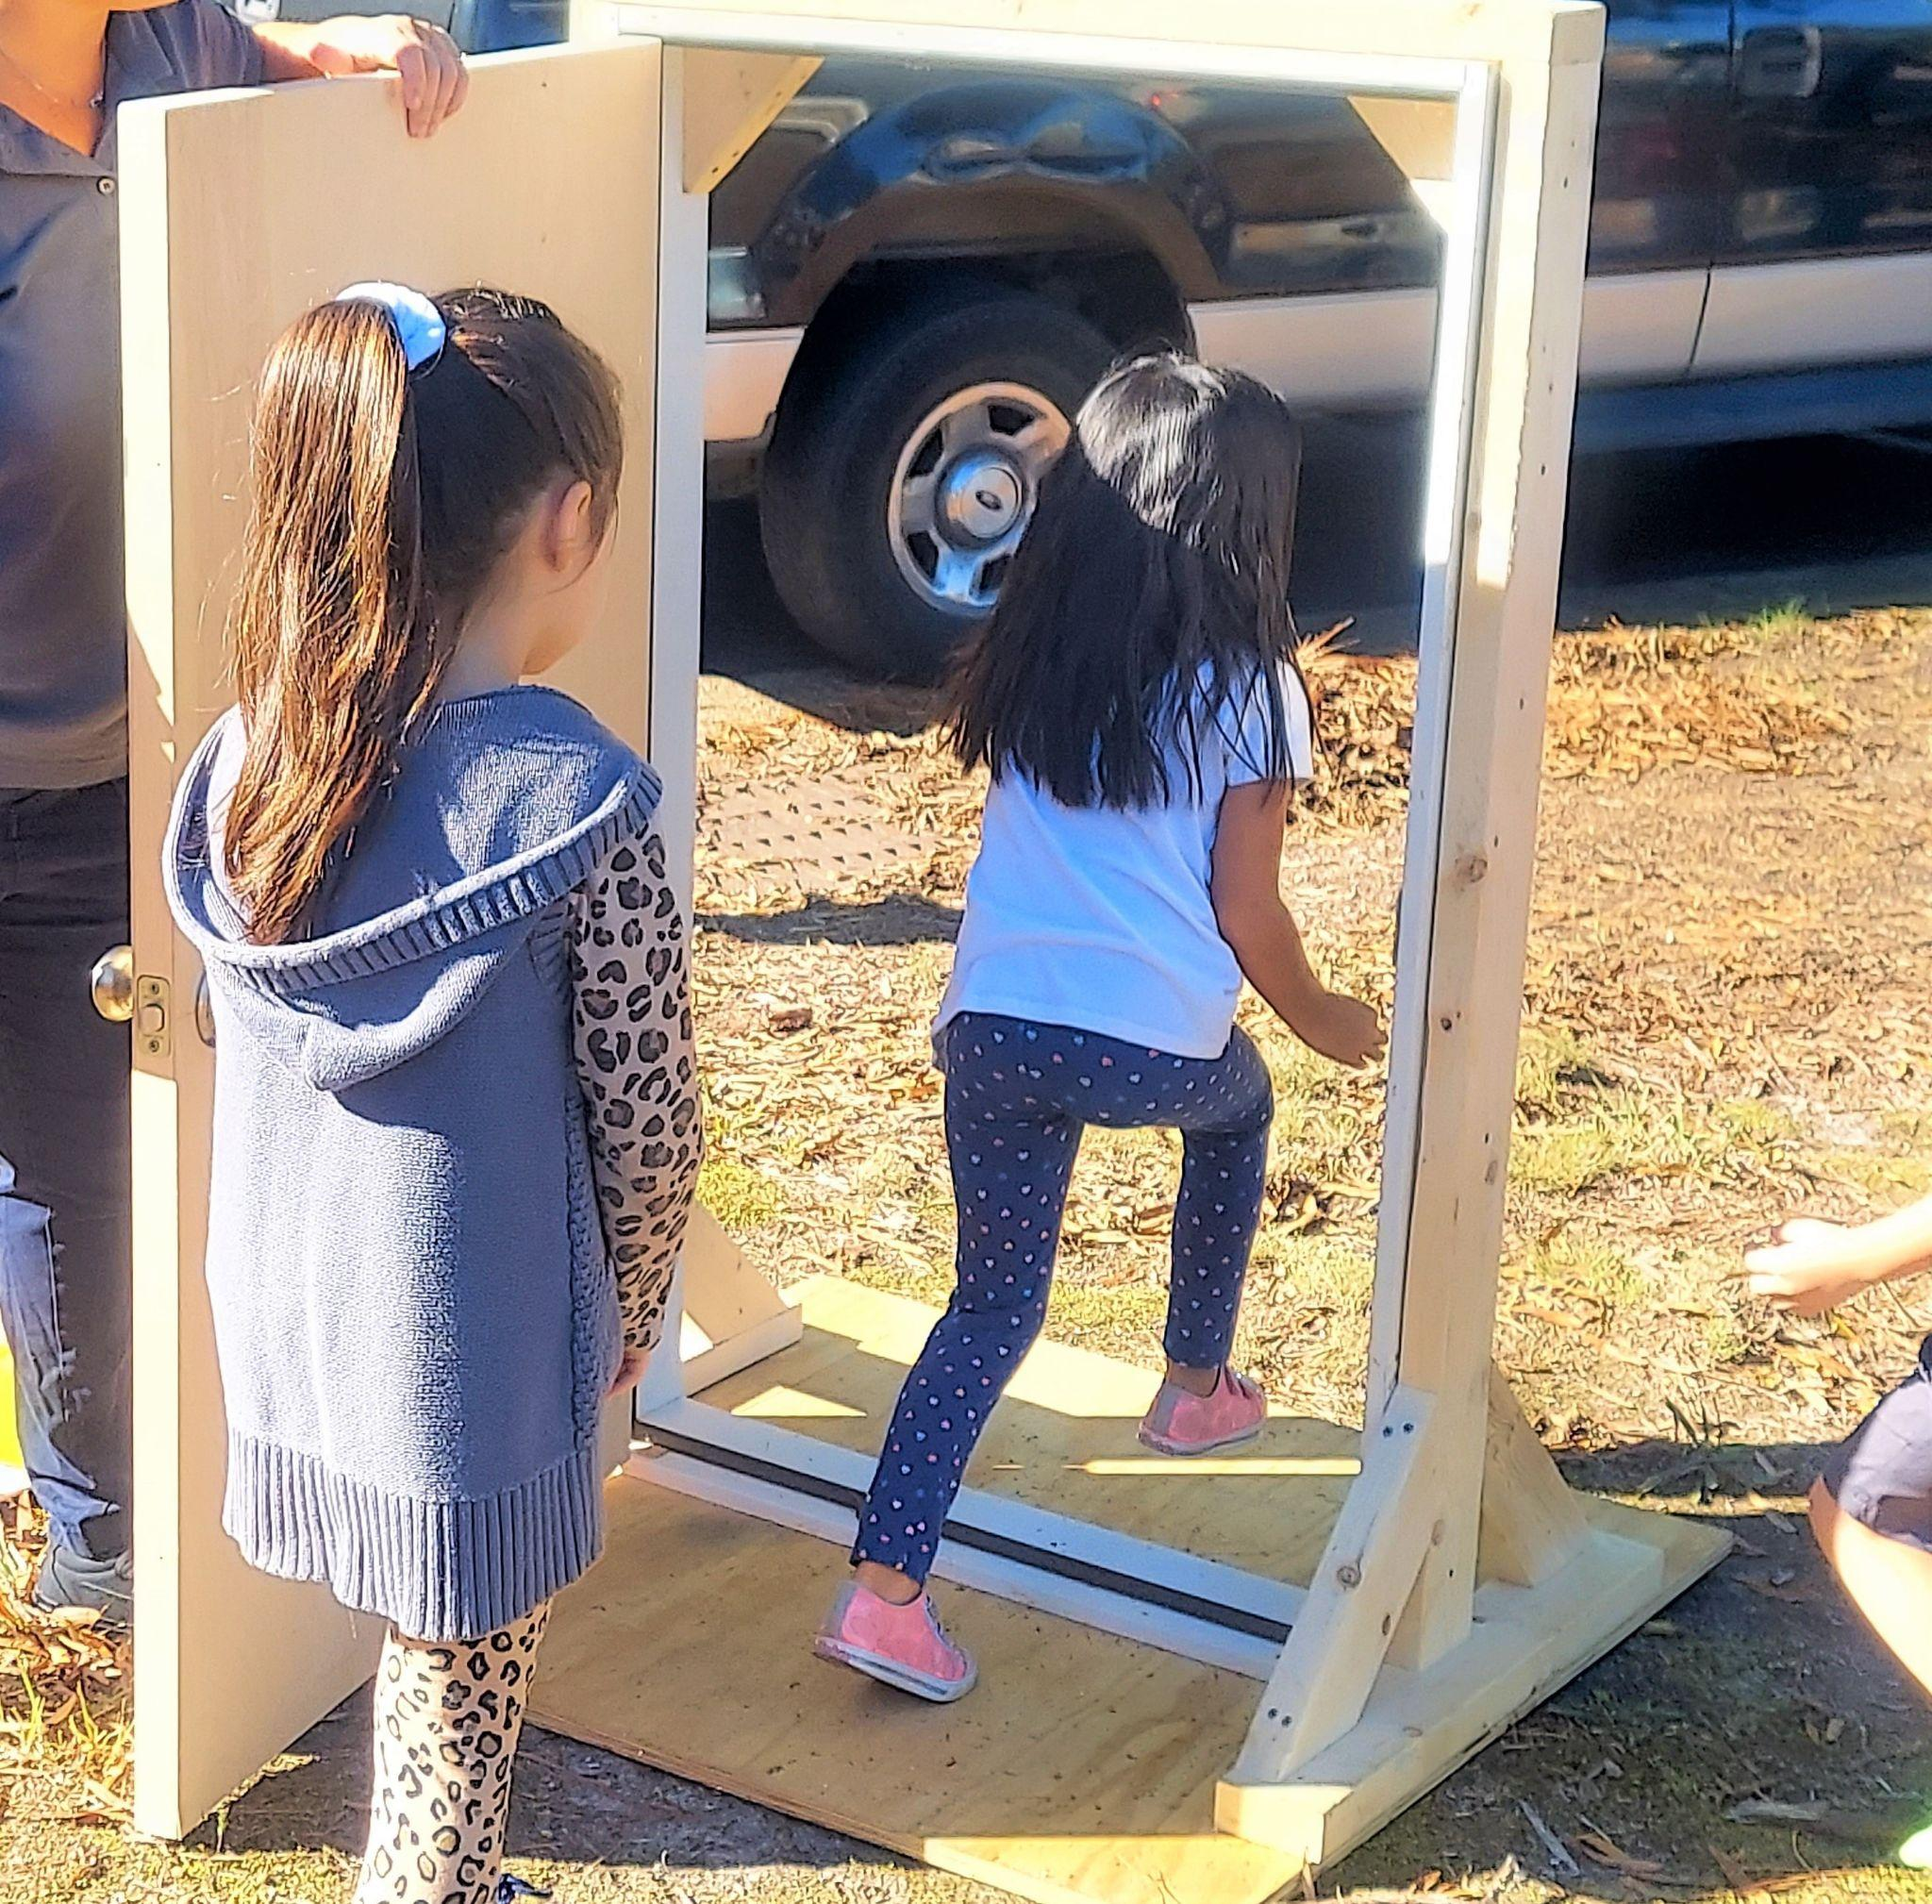
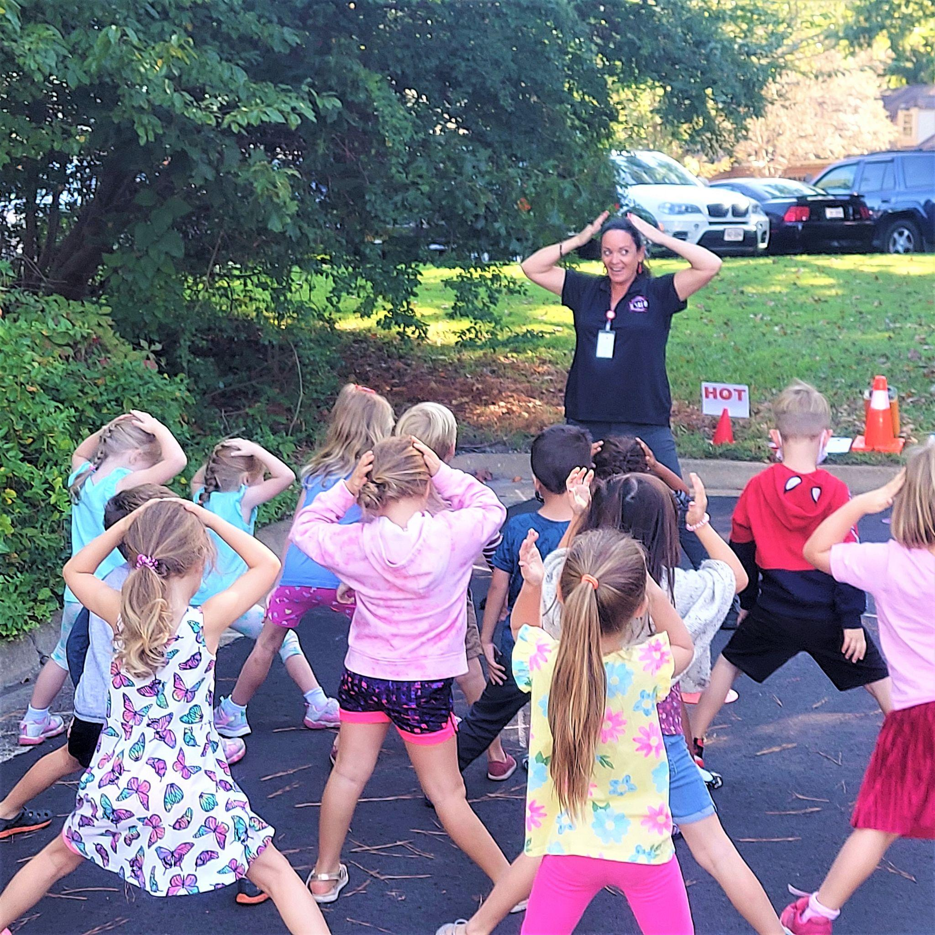
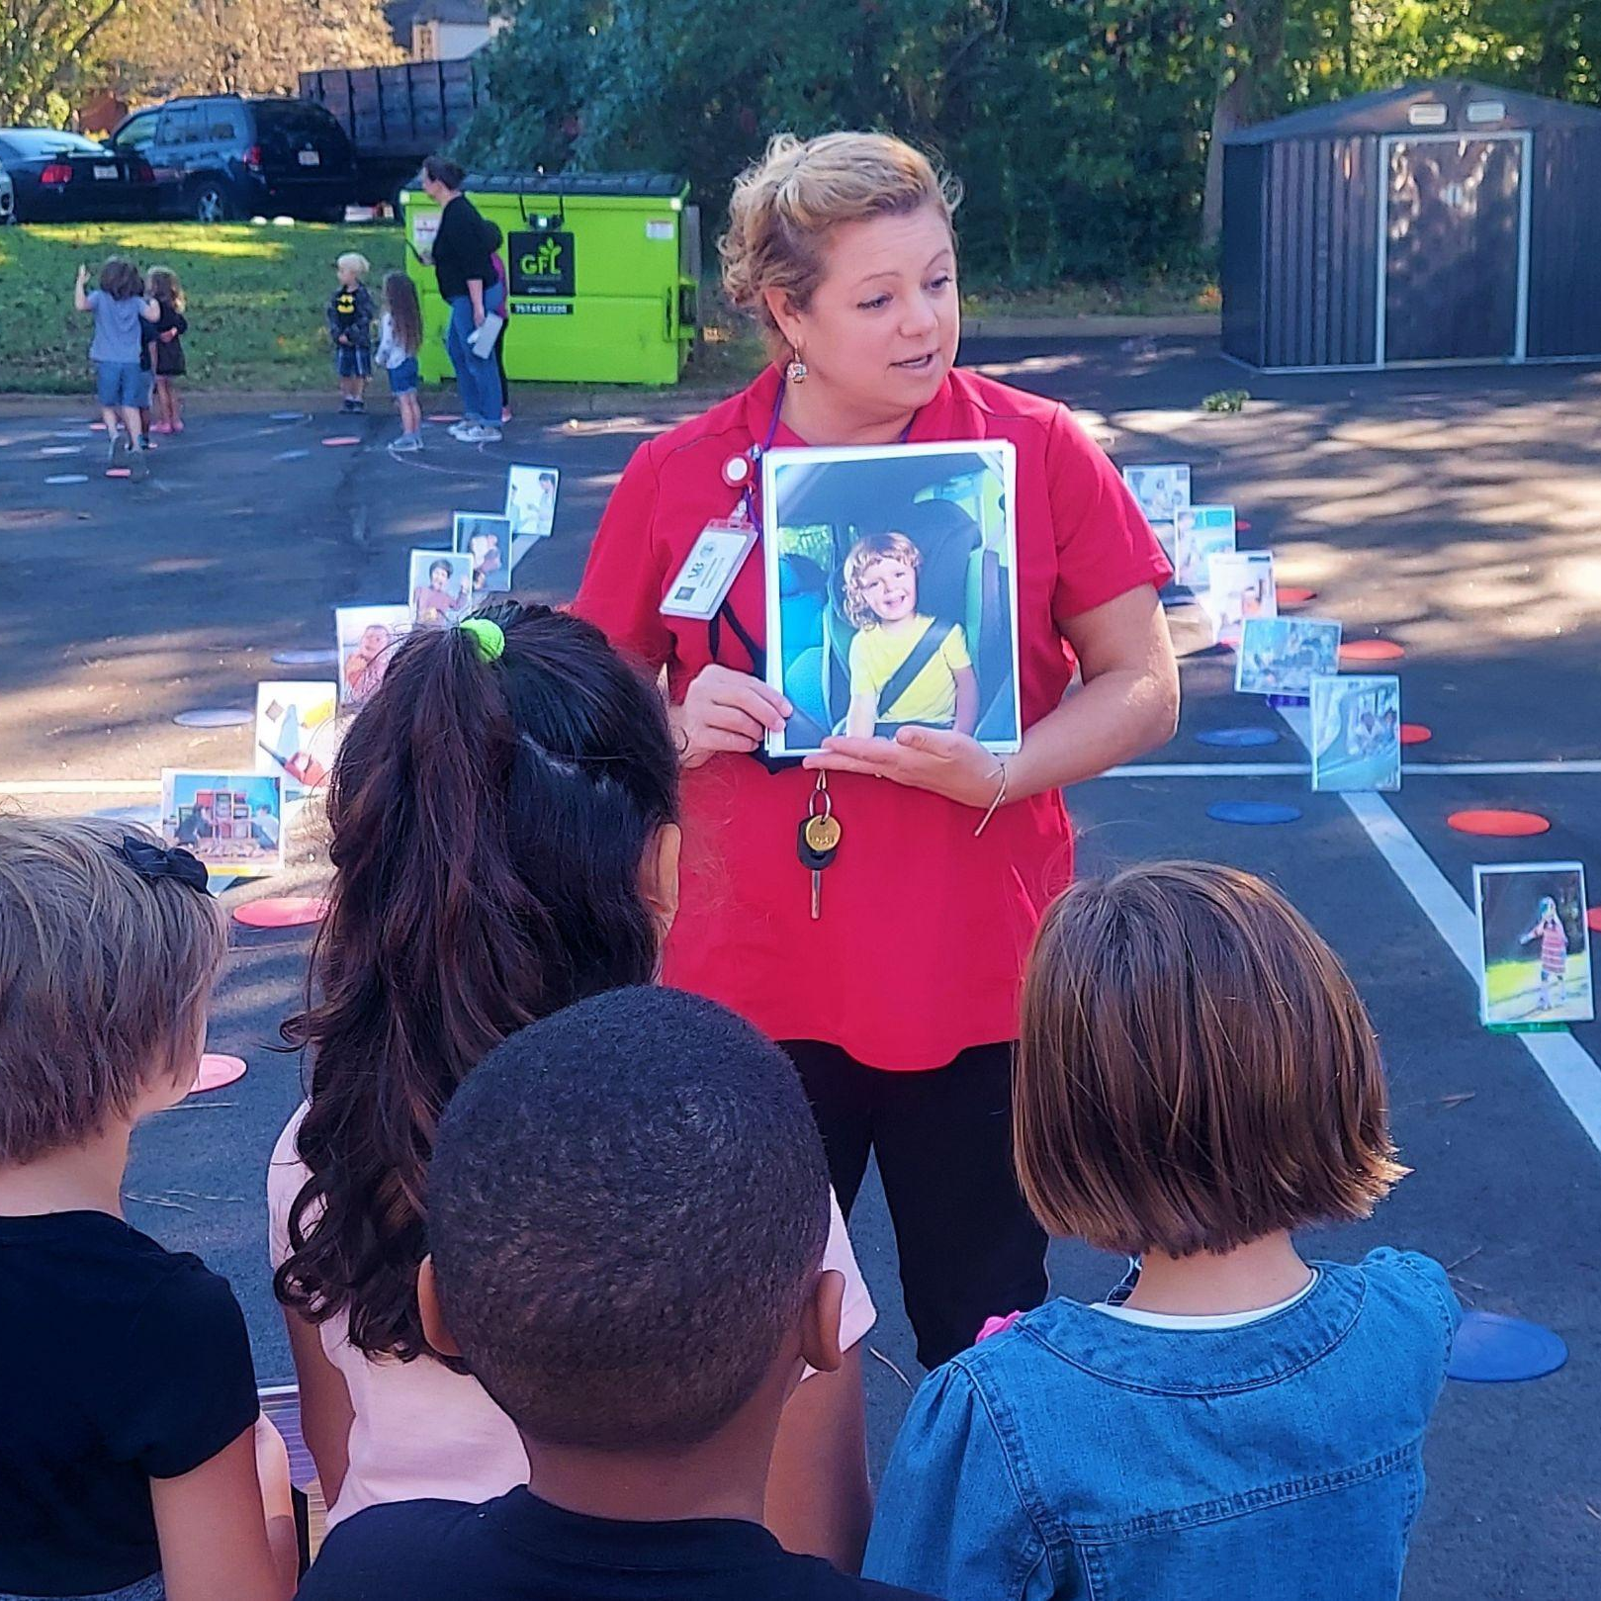

Pre-Lesson Complete!
Now you are ready to practice FIRE SAFETY with Henrico Firefighters! See you soon!

