Slide 1
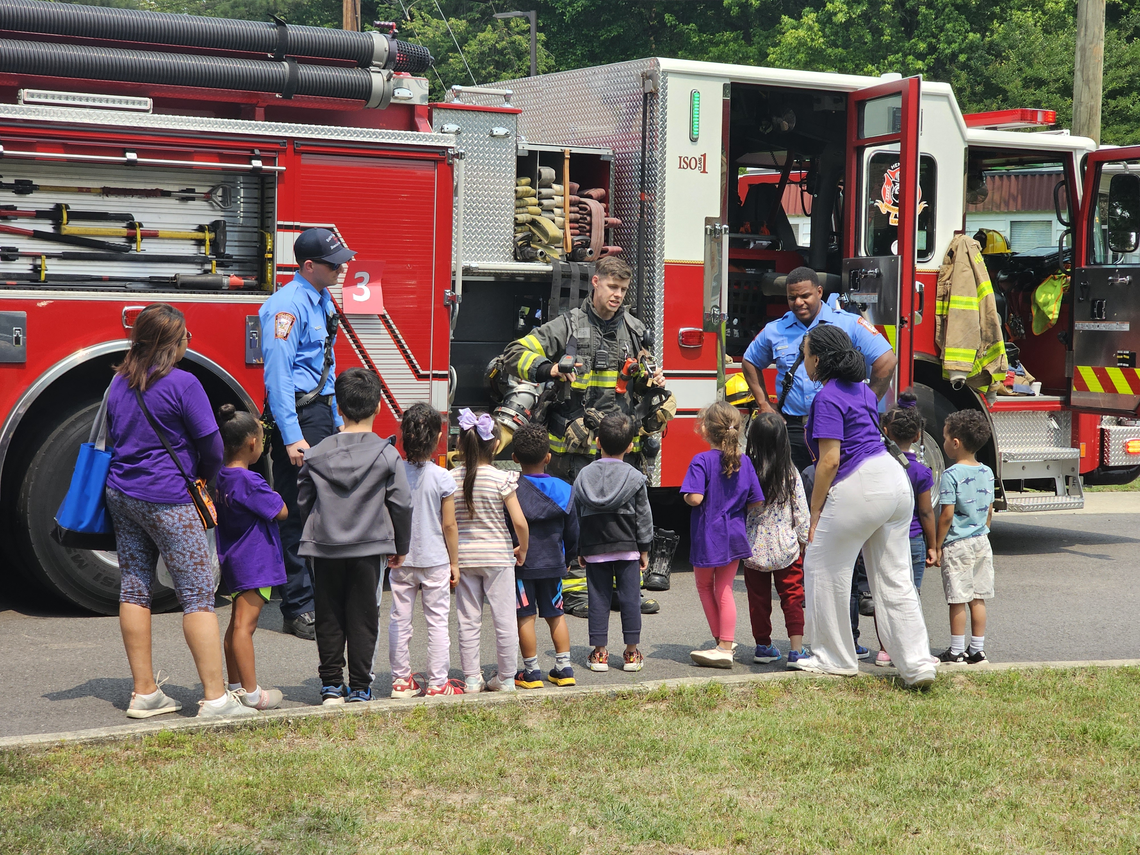
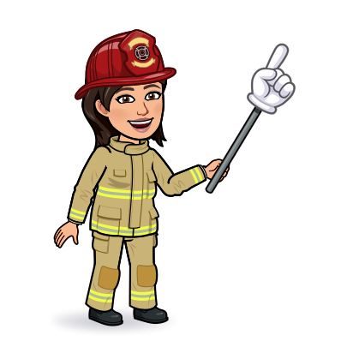

Kindergarten & 1st Grade
Fire Safety

Slide 2

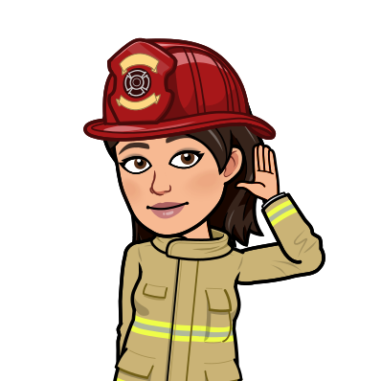
Listen to the Sounds of Fire Safety.
Know WHAT to do when you hear the BEEP-BEEP-BEEP!
The Sounds of Fire Safety!

Slide 3

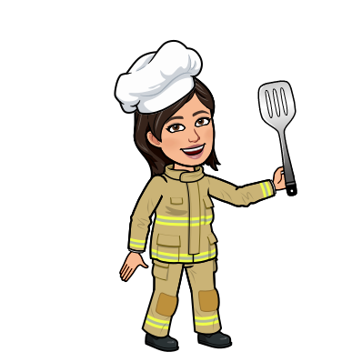
I Spy Cooking Safety!
Learn how to
“Be Safe”
in the kitchen.
Can you
Detect the Dangers?

Slide 4


I Spy Fire Safety!
Can you spot the hazards?

Slide 5
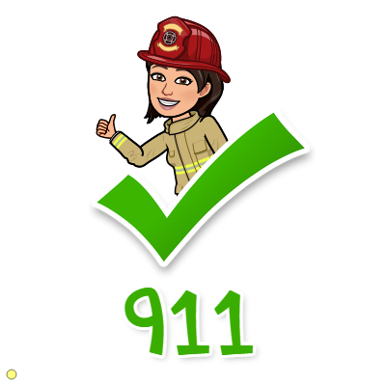
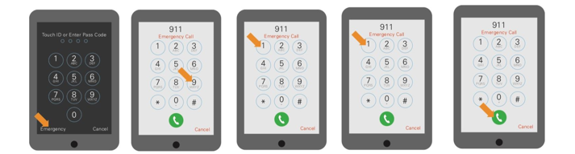
Calling 911 from a Cell Phone
1. Where is the emergency?
2. What is the emergency?
3. Tell them your name & address.
4. Tell them your phone number.
5. Stay on the line until help arrives.
Practice: Teach kids to memorize their address and phone number
Henrico Non-Emergency:
804-501-5000
Notes:
Most emergency calls are made from a mobile phone. Explain that if they do not know the passcode on the mobile phone, they can still call 9-1-1 by pressing the Emergency button and then dialing 9-1-1. Ask students to point to the buttons shown on the diagram as you narrate the steps for making an emergency call. Remind students to never practice calling 9-1-1 on an active phone. As time allows, invite students to work in pairs to practice giving the appropriate information on a pretend emergency call.
How to Dial 9-1-1 Using the Emergency Button
Step 1: Emergency — Children point to the emergency button
Step 2: 9—Children point to the 9
Step 3: 1—Children point to the 1
Step 4: 1—Children point to the 1
Step 5: Call—Children point to the green phone button

Slide 6




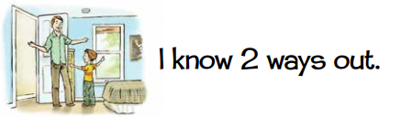


Let's Move! Do you know what to do when
the smoke alarm sounds?

Slide 7
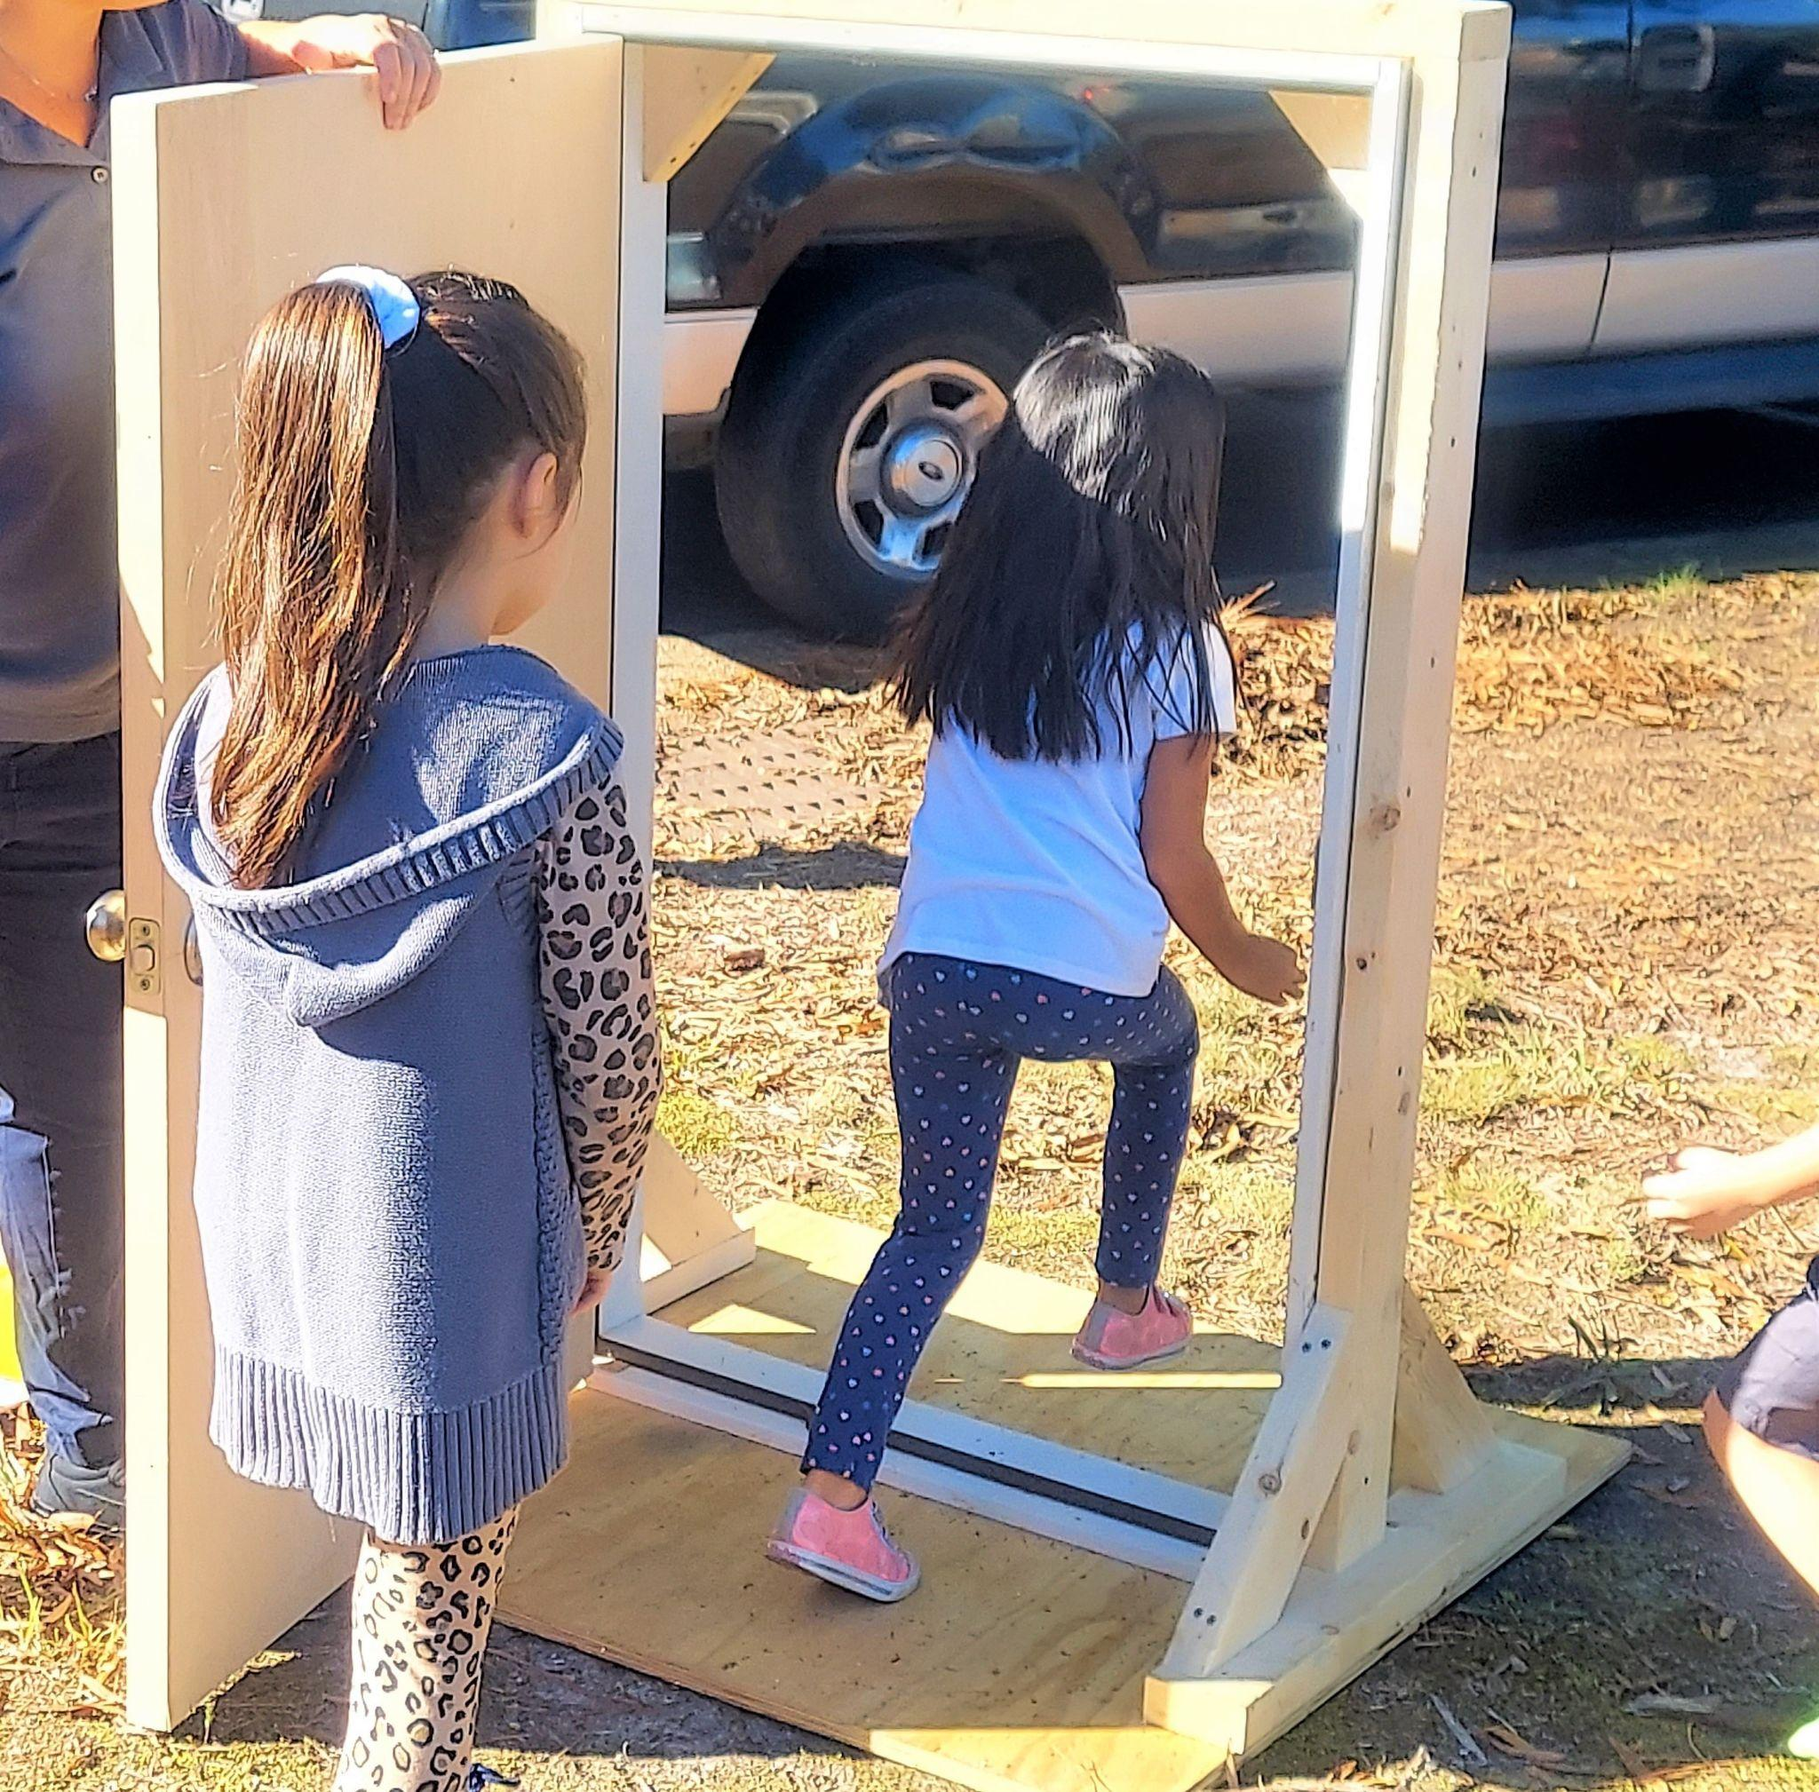
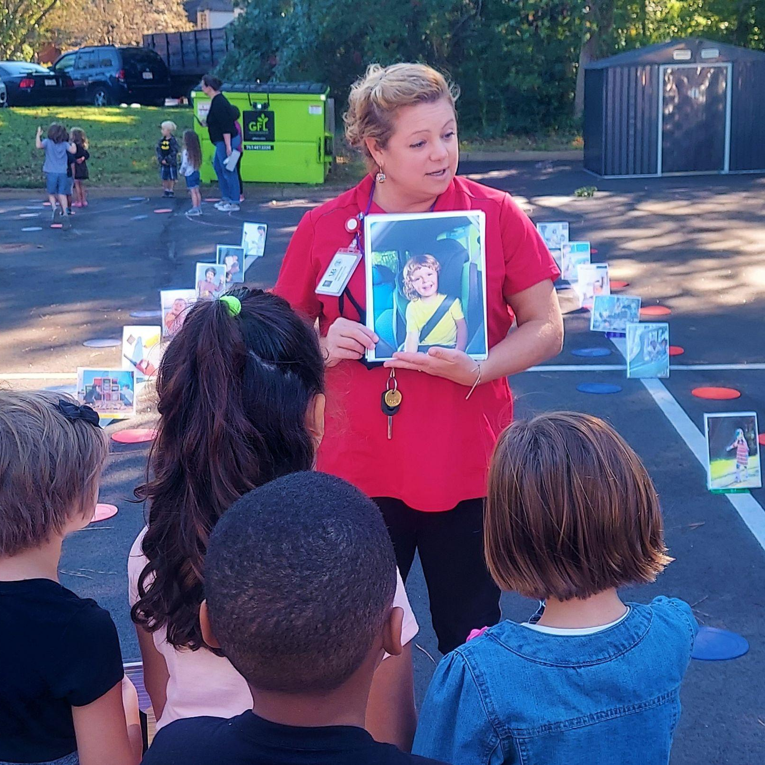
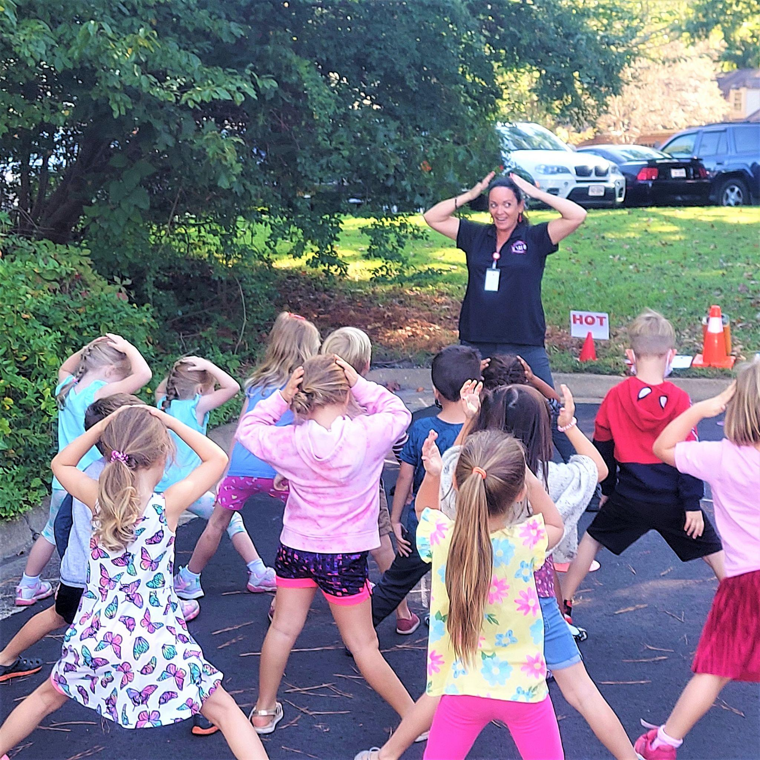

Pre-Lesson Complete!
Now you are ready to practice FIRE SAFETY with Henrico Firefighters! See you soon!

