Slide 1
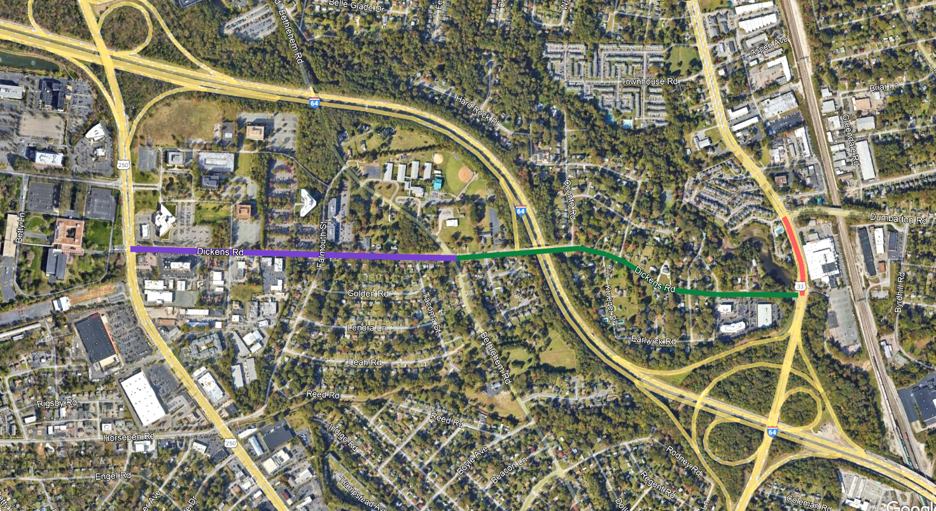
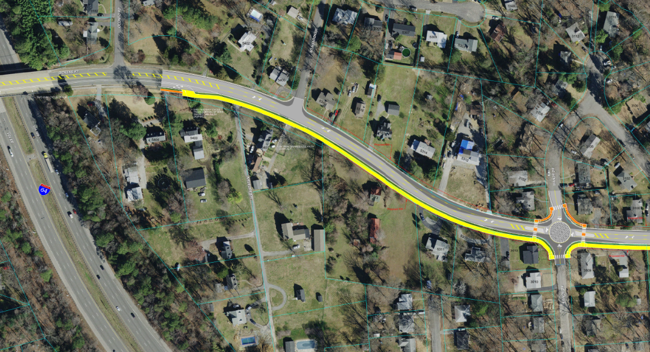
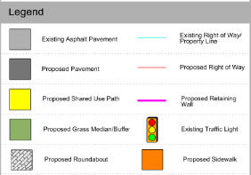
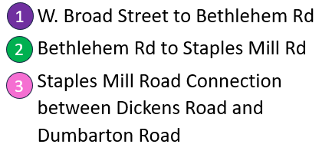
Dickens Road and Staples Mill Road Safety Study W. Broad Street to Staples Mill Road – May 2024
Public Feedback Summary
Segment & Improvement | Priorities Met | Response Summary from Online Survey | Survey Respondent Feedback | Recommended Improvement
W. Broad to Bethlehem Alt. 1: Buffered Bicycle Lanes with Center Turn Lane | Bicycle Safety Vehicle Safety | 75% in Favor (61% Strongly Support, 14% Somewhat Support) | Road diet needed to calm traffic to make bicycle travel safe. Consider physical barrier separating bicycle lanes. Concerns with vehicles parking in bicycle lanes. Consider SUP/two-way protected bike lanes in this area to match adjacent segments. | Alt 1: 3 Lane Roadway with buffered bicycle lanes
Bethlehem to Staples Mill Alternative 2A: Bicycle Lanes with Center Turn Lane Alternative 2B: Protected Two-Way Bicycle Lanes / SUP with Center Turn Lane | Bicycle Safety Ped. Safety Vehicle Safety | Alternative 2A: 63% in Favor (42% Strongly Support, 21% Somewhat Support) Alternative 2B: 75% in Favor (51% Strongly Support, 24% Somewhat Support) | Support for shared use path to better separate bicycles and vehicles. Consistency and transition between segments is important. Request for more detail on how Alt. 1 transitions to the other alternatives. Concern with mini-roundabout proposed at Manor Drive. Suggestions to remove or reduce footprint further. | Alt 2B: 3-Lane Roadway with Protected two-way bicycle lanes / SUP
Staples Mill Rd Alternative 3A: Shared Use Path connecting to Bicycle Lanes on Dickens Alternative 3B: Shared Use Path connecting to Shared Use Path on Dickens | Bicycle Safety Ped. Safety | 72% in Favor (45% Strongly Support, 27% Somewhat Support) 76% prefer Option 3B. | Concern for safety of pedestrians and cyclists using Staples Mill Road due to high traffic volumes. Prefer off-street (SUP) alternative to limit interaction with cars. Consider pedestrian refuges for any crossing of Staples Mill Road. | Alt 3B: Shared Use Path on east side of Staples Mill Rd connecting to Shared Use Path on south side of Dickens Rd
The Henrico County Department of Public Works has been conducting a study of 1.3 miles of Dickens Road between W. Broad Street and Staples Mill Road and 0.2 miles of Staples Mill Road between Dickens Road and Dumbarton Road to identify potential measures to improve bicycle and pedestrian travel and safety along the corridor. Needs identified as part of the study include no designated bicycle facilities, lack of continuous sidewalk, a lack of safe crossings of Staples Mill Road, and lack of turn lanes for vehicular movements. Feedback was collected by an online survey accompanied by a virtual presentation showing conceptual designs. The online survey and presentation was advertised via social media, the County website, Henrico newsletter, and other forms of outreach. There were 70 survey responses received in May 2024. As part of the survey, respondents were asked if the existing roadway in the study area meets their safety and mobility concerns and 63% of the respondents said the existing facility does not meet their needs. The study area was divided into 3 main segments, each with different potential alternatives. The concepts presented in the virtual presentation highlighted these possible solutions. The table to the right summarizes the improvement concepts and public feedback. Overall, 83% of respondents said that the proposed changes would address their safety and mobility concerns within the study area.
What Happens Next?
Next steps will include preparing design plans to advance design of the recommended improvements. The improvement may be phased based on available funding and the need for any right-of-way acquisition. Additional public outreach will occur in the future as projects progress. If there is additional input, please contact Ryan Levering at LEV004@henrico.gov.
Proposed Dickens Road Typical Section – Alternative 2B
Alternative 2B
3
1
2
10’
Shared Use Path

